Slide 1
INFORMATION THEORY
Week 4
Conditional entropy
IITU, ALMATY, 2019
Notes:
IITU, Almaty, Fall 2012
SEPTEMBER 5, 2012
By Assem Zhamankulova, MSCS

Slide 2
Conditional entropy
Conditional entropy quantifies the amount of information needed to describe the outcome of a random variable Y given that the value of another random variable X is known.
The entropy of Y conditioned on X is written as H(Y|X).

Slide 3
Simple vs. Conditional
In case of
1 event:
Probability
Entropy
In case of
2 events
Conditional probability
Conditional entropy

Slide 4
Chain rule
Assume that the combined system determined by two random variables X and Y has joint entropy H(X,Y), that is, we need H(X,Y) bits of information to describe its exact state. Now if we first learn the value of X, we have gained H(X) bits of information. Once X is known, we only need H(X,Y) - H(X) bits to describe the state of the whole system. This quantity is exactly H(Y|X), which gives the chain rule of conditional entropy:
H(Y|X) = H(X,Y) - H(X)
or H(X,Y) = H(X) + H(Y|X)

Slide 5
Joint Entropy
Joint entropy is a measure of the uncertainty associated with a set of variables.
Properties:
  The joint entropy of a set of variables is greater than or equal to all of the individual entropies of the variables in the set.
  The joint entropy of a set of variables is less than or equal to the sum of the individual entropies of the variables in the set.

Slide 6

Conditional Entropy
Formula for conditional entropy

Slide 7
Example 1
A box contains 2 white and 4 black balls. We draw 2 balls consequentially without replacement. Find the entropy of first and second extractions and the entropy for both of them.

Slide 8
Example 1: events
α — a first ball is drawn
β — a second ball is drawn

Slide 9
Example 1: event α
α — a first ball is drawn
А1 — white ball
р(А1) = 2/6 = 1/3
А2 — black ball
р(А2) = 4/6 =2/3
Н(α) = -1/3log1/3 - 2/3log2/3 = 0,918 bit

Slide 10
Example 1: event β
β — a second ball is drawn
After А1 (after white ball) :
В1 — white ball: р(В1) = 1/5
В2 — black ball: р(В2) = 4/5
After А2 (after black ball) :
В3 — white ball: р(В3) = 2/5
В4 — black ball: р(В4) = 3/5
НА1(β) = -1/5log1/5 - 4/5log4/5 = 0,722 bit
НА2(β) = -2/5log2/5 - 3/5log3/5 = 0,971 bit

Slide 11
Example 1: Solution
НА1(β) = -1/5log1/5 - 4/5log4/5 = 0,722 bit
НА2(β) = -2/5log2/5 - 3/5log3/5 = 0,971 bit
Нα(β) = р(А1)* НА1(β) + р(А2)* НА2(β) =
=1/3*0,722 + 2/3*0,971 = 0,888 bit
Н(α) = -1/3log1/3 - 2/3log2/3 = 0,918 bit
Н (α*β) = Н(α) + Н α(β) = 0,918 + 0,888 = 1,806 bit

Slide 12
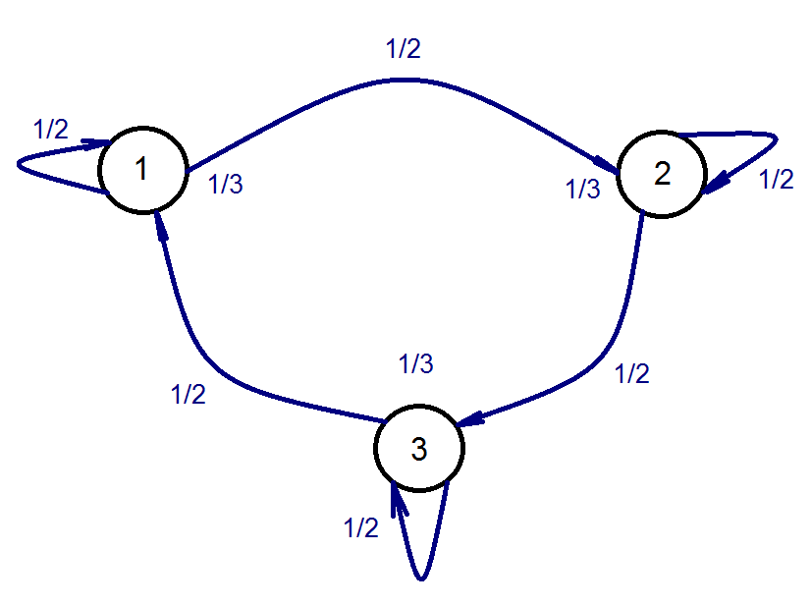
Example 2
Find the entropy of the source described by the graph of transition probabilities.

Slide 13
Example 2
α — a state
β — a transition

Slide 14
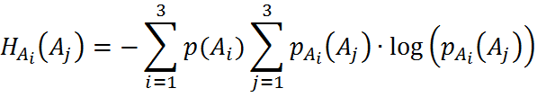




Example 2: solution

Slide 15
Totally dependent and
Independent values
H(Y|X) =0 if and only if the value of Y is completely determined by the value of X.
Conversely, H(Y|X) = H(Y) if and only if Y and X are independent random variables.
H(X,Y) = H(X) + H(Y)

Slide 16
Bayes' rule
Bayes’ rule for conditional entropy states:
H(Y|X) = H(X|Y) - H(X) + H(Y)
or H(X) + H(Y|X) = H(Y) + H(X|Y)

Slide 17

Example 3.1
An alphabet consists of two elements 0 and 1.
Situation 1: elements are equally probable

Slide 18


Example 3.2
An alphabet consists of two elements 0 and 1.
Situation 2: elements have different probabilities: p(0)=3/4, p(1)=1/4.

Slide 19

Example 3.3
An alphabet consists of two elements 0 and 1.
Situation 3: elements are interdependent and determined by the conditional probabilities: p(0|0)=2/3; p(1|0)=1/3; p(0|1)=1; p(1|1)=0.

Slide 20
Lab work 4
1. A box contains 3 white and 6 black balls. We draw 2 balls consequentially without replacement. Find the entropy of first and second extractions and the entropy for both of them.
2. We have 3 objects that have the same size but different mass x1, x2 and x3. Find the entropy of drawing the heaviest of them. You can compare weights of objects only in pairs.
3. You had 10 cards with numbers from 0 to 9, but 1 card was lost. Find the entropy of drawing the prime number?

Slide 21
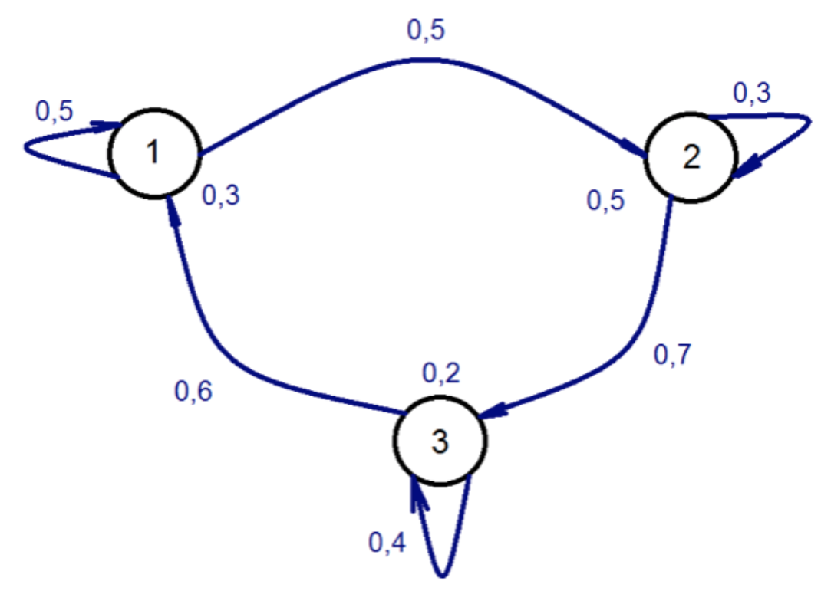
Lab work 4
4. Find the conditional entropy of the source described by the graph of transition probabilities.
5. Elements of alphabets X and Y are statistically related. It is known that H(X)=8 bits and H(Y)=12 bits. What are a range of variation for a conditional entropy H(Y|X) when H(X| Y) changes from its min to max?

